Slide 1

Database Management Systems
Shamim Ahmad

Slide 2
RAID

Slide 3
RAID
The choice of disk structure is very important in databases. Important factors, besides price, are:
Capacity
Speed
Reliability
RAID: Redundant Arrays of Independent Disks
disk organization techniques that manage a large numbers of disks, providing a view of a single disk of
high capacity and high speed by using multiple disks in parallel, and
high reliability by storing data redundantly, so that data can be recovered even if a disk fails

Slide 4
Improvement of Reliability via Redundancy
Redundancy – store extra information that can be used to rebuild information lost in a disk failure
E.g., Mirroring (or shadowing) – RAID level 1
Duplicate every disk. Logical disk consists of two physical disks.
Every write is carried out on both disks
Reads can take place from either disk
If one disk in a pair fails, data still available in the other
Data loss would occur only if a disk fails, and its mirror disk also fails before the system is repaired
Probability of combined event is very small, (except for dependent failure modes such as fire or building collapse or electrical power surges)
Mean time to data loss depends on mean time to failure, and mean time to repair

Slide 5
Mean Time to Failure (MTTF)
Definition
MTTF is the average time a disk or system operates before it fails.
It is usually measured in:
Hours
Days
Years
For hard disks, manufacturers often specify values like:
1,000,000 hours
1.5 million hours
2 million hours

Slide 6
Example
Suppose:
One HDD has an MTTF of 1,000,000 hours
This means:
On average, the disk is expected to fail once every 1,000,000 operating hours.
It does not mean the disk will definitely last 1,000,000 hours.

Slide 7
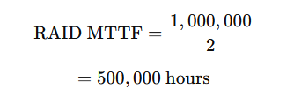
RAID Example
Assume:
RAID 1 contains 2 disks
Each disk MTTF = 1,000,000 hours
Since either disk can fail, the RAID experiences a disk failure more frequently.
Approximate RAID failure rate:
In RAID with more disks,
chance of one disk failing increases.

Slide 8
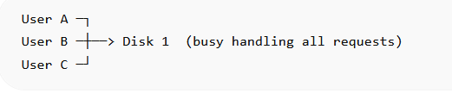
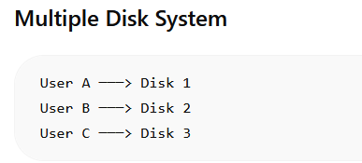
Improvement in Performance via Parallelism
Two main goals of parallelism in a disk system:
1. Load balance multiple small accesses to increase throughput
2. Parallelize large accesses to reduce response time.
Improve transfer rate by striping data across multiple disks.

Slide 9
Improvement in Performance via Parallelism
Improve transfer rate by striping data across multiple disks.
Bit-level striping – split the bits of each byte across multiple disks
In an array of eight disks, write bit i of each byte to disk i.
Each access can read data at eight times the rate of a single disk.
But seek/access time worse than for a single disk
Bit level striping is not used much any more

Slide 10
Improvement in Performance via Parallelism
Block-level striping – with n disks, block i of a file goes to disk (i mod n) + 1
Requests for different blocks can run in parallel if the blocks reside on different disks
A request for a long sequence of blocks can utilize all disks in parallel
Usually called RAID level 0

Slide 11
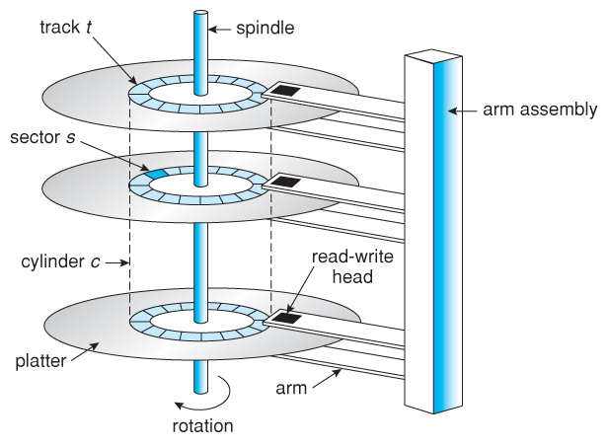

Slide 12
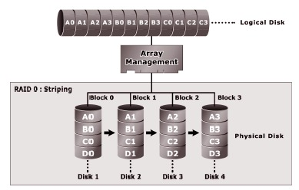

Slide 13
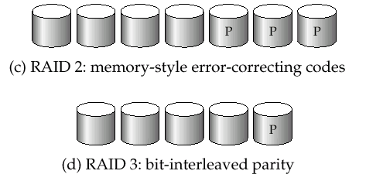
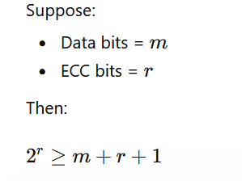
RAID Levels 2 and 3
RAID Level 2: Memory-Style Error-Correcting-Codes (ECC) with bit striping.
RAID Level 3: Bit-Interleaved Parity
a single parity bit is enough for error correction, not just detection, since we know which disk has failed
When writing data, corresponding parity bits must also be computed and written to a parity bit disk
To recover data in a damaged disk, compute XOR of bits from other disks (including parity bit disk)

Slide 14
Choice of RAID Level
Mirroring provides much better write performance than Parity
For Parity read operations are needed before a write, whereas Mirroring only requires 2 writes
Mirroring preferred for high update environments such as log disks
Mirroring needs more disks for the same capacity
Higher cost per capacity unit
But price of storage capacity is already low and decreasing
Nowadays, for database systems
(Distributed) Parity, with RAID Level 5, is preferred for applications with low update rate, and large amounts of data
Mirroring is preferred for all other applications
The choice of the storage structure is an important first step when designing a real database!

Slide 15
RAID Implementations
Hardware (usually a specialized disk controller card)
Controls all drives attached to it
Array(s) appear to host operating system as a regular disk drive
Provided with administrative software
Software
Runs as part of the operating system
Performance is dependent on CPU workload
Does not support all RAID levels

Slide 16
Block 0
Block 0
Block 4
Block 1
Block 5
Parity Generated
Block 2
Block 0
RAID Controller
Block 0
Block 6
P 0 1 2 3
Block 3
Host
Block 7
P 0 1 2 3
P 0 1 2 3
P 4 5 6 7
Notes:
RAID Level 4 stripes data for high performance and uses parity for improved fault tolerance. Data is striped across all the disks, but one in the array. Parity information is stored on a dedicated disk so that data can be reconstructed if a drive fails.
The data disks are independently accessible, and multiple reads and writes can occur simultaneously.
Benefits - the total number of disks is less than in a mirrored solution (e.g., 1.25 times the data disks for group of 5), good read throughput, and reasonable write throughput.
Drawbacks – the dedicated parity drive can be a bottleneck when handling small data writes. This RAID level is not well suited to transaction processing applications. Data loss if multiple drives fail within the same RAID 4 Group.
Performance - high data read transfer rate. Poor to medium write transfer rate. Disk failure has a significant impact on throughput
Data Protection - uses parity for improved fault tolerance.
Striping – usually at the block (or block multiple) level
Applications – general purpose file storage
RAID 4 is much less commonly used than RAID 5, discussed next. The dedicated parity drive is a bottleneck, especially when a disk failure has occurred.

Slide 17

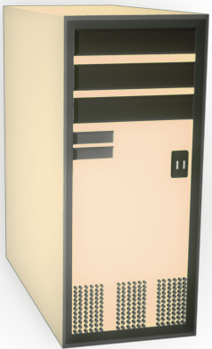
Block 0
Block 0
Block 4
Block 4
Block 1
Block 5
Parity Generated
Block 2
Parity Generated
Block 4
RAID Controller
Block 0
Block 0
Block 4
Block 6
P 0 1 2 3
P 4 5 6 7
Block 3
Host
P 4 5 6 7
P 4 5 6 7
P 0 1 2 3
P 0 1 2 3
Block 7

